Slide 1



SUPERSTORE DATA ANALYSIS USING SNOWFLAKE

Slide 2


WHAT IS SNOWFLAKE?
Snowflake is a cloud computing-based data warehousing solution.
Founded in 2012, Snowflake offers storage and analytics services.
It runs on Amazon S3, Microsoft Azure, and the Google Cloud platform.

Slide 3


INTRODUCTION
AIM : Implementing the snowflake methodologies on superstore data from public repository Kaggle.
SYSTEM REQUIRED : Window OS
PLATFORM’s USED : Snowflake, GIT-HUB
CLOUD PLATFORM : AWS
LANGUAGES USED : PYTHON, SQL

Slide 4

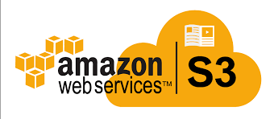

WORK FLOW
GIT-HUB
Notes:
To perform the snowflakes methodologies on the dataset, the dataset is extracted from the Kaggle and to reduce the complexity, the data is made into chunks using python.
Later the data is loaded into AWS s3 Bucket where the snowflake has the access to copy the data from external stage.
After copying the data from external object, snowflake performs the required actions based on the requirement.
Later the whole computed and simplified results and code are pushed into git-hub where git-hub is a platform to share the code where everyone has the access of visualizing the code and data.

Slide 5

SUPERSTORE DATA SET
With growing demands and cut-throat competitions in the market, a Superstore Giant is seeking knowledge in understanding what works best for them.
They would like to understand which products, regions, categories and customer segments they should target or avoid.
Dataset containing Information related to Sales, Profits, Products and other interesting facts of a Superstore giant.
Here, superstore data is downloaded from the Kaggle.
(https://www.kaggle.com/datasets/vivek468/superstore-dataset-final)
Notes:
For example, if we consider the whole data of the orders and sales of an IKEA store organisations where the data varies from region to region and state to state
We are going to get the information of the orders data, sales of a product, profit attained, etc.
So for performing tasks to get only the required data initially we have to download it and here the data is downloaded from Kaggle.

Slide 6
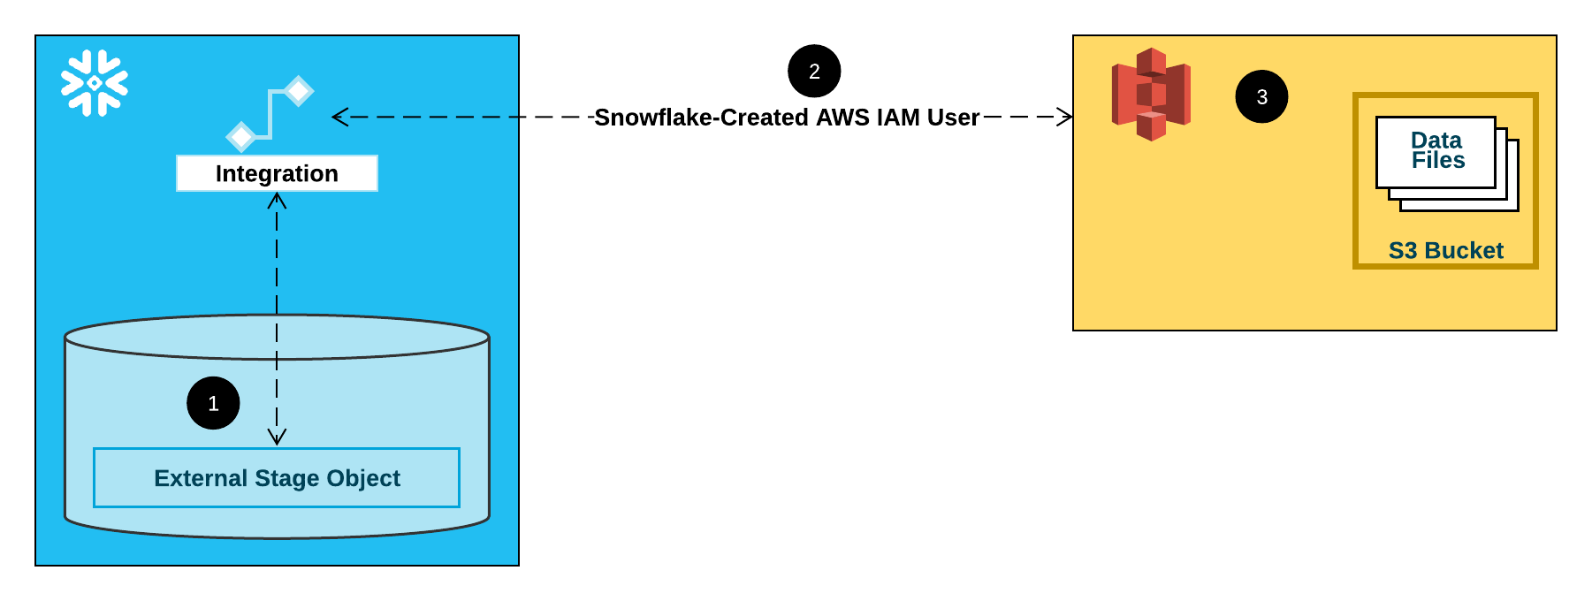
AWS TO SNOWFLAKE
Exploratory Data Analysis on superstore data to decrease complexity.
In order to copy the data from the external stage i.e., AWS s3 Bucket , a storage integration is created in snowflake for connecting it with s3 bucket.
Stages and tables are created for copying the data from s3 bucket into snowflake.

Slide 7

TASK SCHEDULING
A task is created for scheduling, from where and when it has to be performed.
The cron expression is used to schedule a job in specific time zone in unique environment.
Tasks scheduled during specific times on days when the transition from standard time to daylight saving time (or the reverse) occurs can have unexpected behaviors.

Slide 8

SLOWLY CHANGING DIMENSION
A Slowly Changing Dimension (SCD) is a dimension that stores and manages both current and historical data over time in a data warehouse.
Stream is a methodology which captures DML changes on particular table.
Here, SCD2 is used which has the capability of storing each and every change in table i.e., contains complete history.

Slide 9
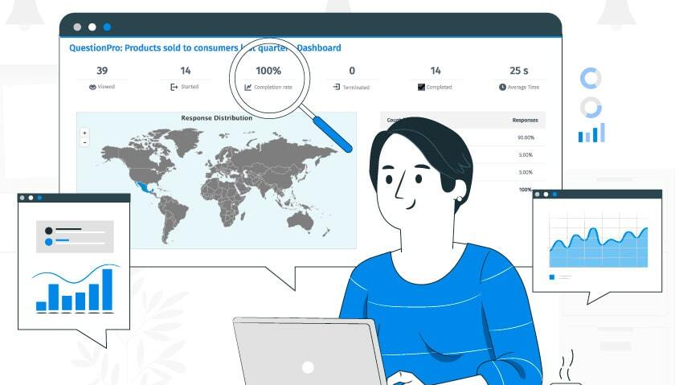
ANALYSIS ON THE DATASET
The following analysis are performed on our superstore dataset.
Calculate the number of Orders those with Ship Mode a ‘Second Class’?
List down the most valuable customers Country wise?
Total Sales for Category ‘Furniture’?
Which Product provides the maximum profit?
Calculate the total profit made by each product category country wise?
Which region of United States have majority loss?

Slide 10

ROW LEVEL SECURITY
Selection of particular rows, based on a unique id or name is known as ‘Row Level Security’.
Since, on the superstore we are going to perform row level security based on the region of the states in US.
The manager or head of that particular region can only have the access to data of that specific region.

Slide 11

GIT-HUB
GitHub is an increasingly popular programming resource used for code sharing. It's a social networking site for programmers that many companies and organizations use to facilitate project management and collaboration.
As the final step of the project the code of the project is shared in GitHub repository as a snowflake_code.txt file which has the visibility to everyone.
( https://github.com/sunilmann/Superstore_Project )

Slide 12
CONCLUSION
The data is successfully made into chunks and loaded into our AWS s3 Bucket.
External stage is created hereby enabling us to connect our snowflake to AWS.
Row level security has been implemented on region for providing access of data of particular region only to the manager of that region.
After successful data loading, different queries are performed in order to extract the required data from the dataset. For example, maximum profits attained, sales information of different products, means of shipping the order and so on.

Slide 13

Thank You
Presented By:
Tejaswini
Sunil
Abhinav
Meghana
Vikas Sony
Mentored by:
Mr. Pritam G

